Slide 1
Will They Claim It?
- Weekend warriors

Slide 2
Problem Statement
Construct a Data Science prototype that analyzes the provided data and forecasts whether a travel insurance claim is to be sanctioned or rejected.
Lets consider a scenario where a customer who has purchased a travel insurance product is applying for an insurance claim. In this case, the problem statement is to create a Data science model that predicts whether the insurance claim is to be sanctioned or not based on the data imputted into the model.

Slide 3
Why solve this problem?
Improves transparency. (Between sales and finance teams to calculate the credit and debit cash flow.)
Reduces manual intervention. (In the process of sanctioning claims resulting into human resource savings and reducing human prone error.)
Helps in determining business KPIs and business planning faster
Data availability would be faster with higher accuracy helping to drive business decisions and determining the costs of products.
Stakeholders – CEO, CFO and Sales Team

Slide 4
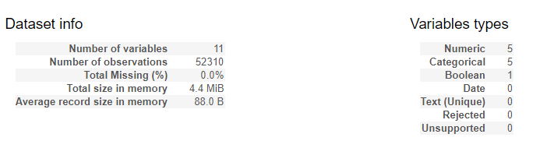
Data

Slide 5
The predictions and inferences would have been more insightful if following additional details were to be added:
Gender – The data would provide additional insights on the number of claims received classified by Gender and also the distribution of claim across it
Cost of Product - Cost of the product plan would help deriving insights as to how the claim sanctions are related to the expensive plans as compared to cheaper ones
Reason of rejection of claims – If reasons were provided for the rejection of certain claims, it would have been helpful to form a group of common reasons to reject claims.

Slide 6
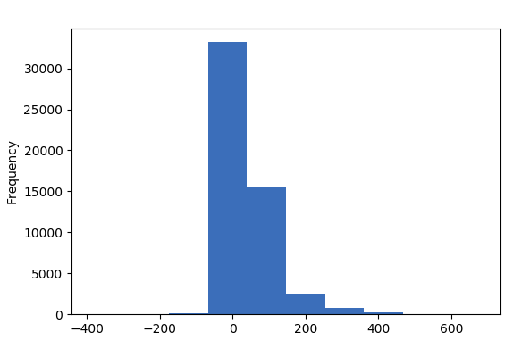
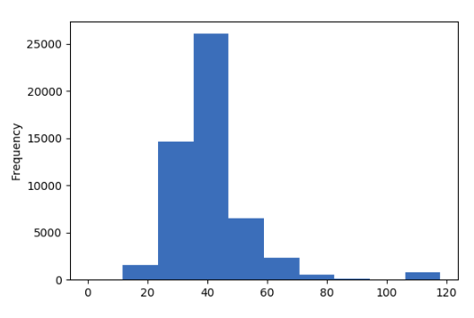
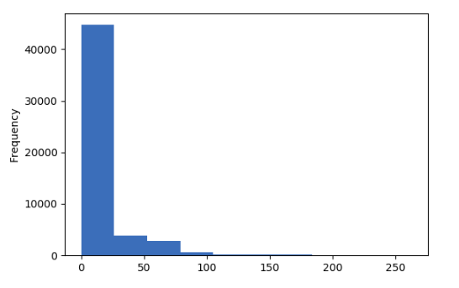
Exploratory Data Analysis (Univariate)
Net Sales
Age
Commission

Slide 7
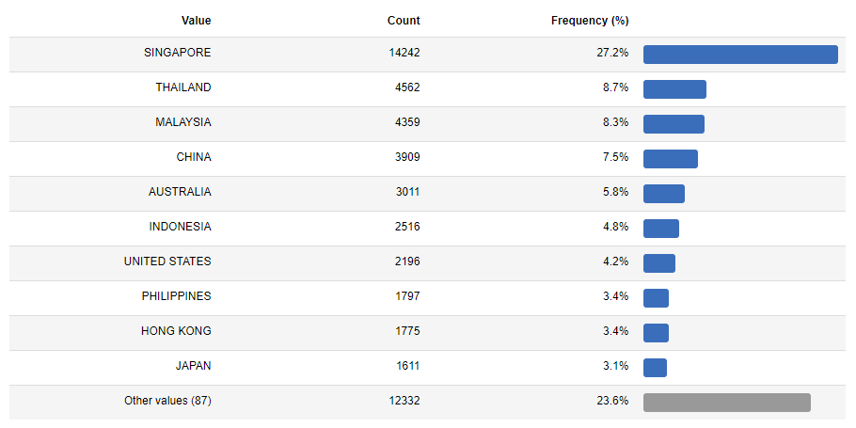
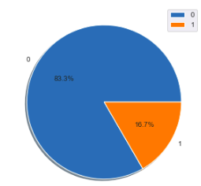
EDA (Univariate)
Destination
Claim pie chart

Slide 8
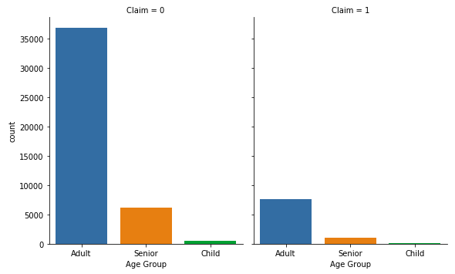
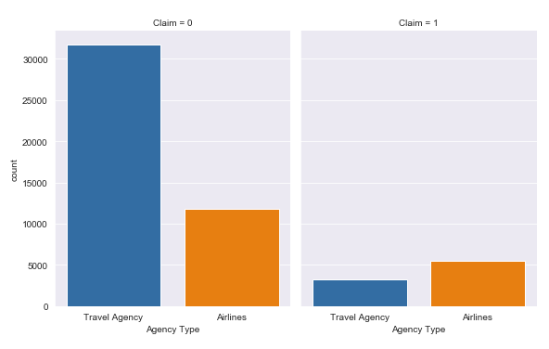
EDA (Bivariate)
Claim with Age group
Claim with Agency Type

Slide 9
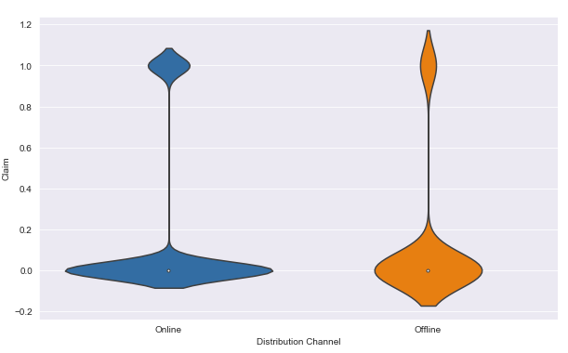
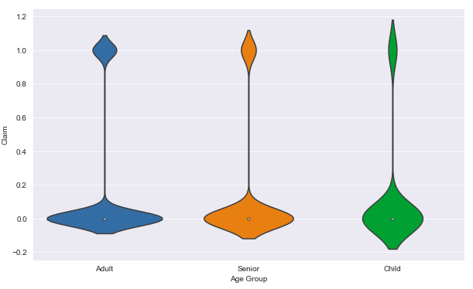
EDA (Bivariate)
Claim with Distribution channel
Claim with age groups

Slide 10
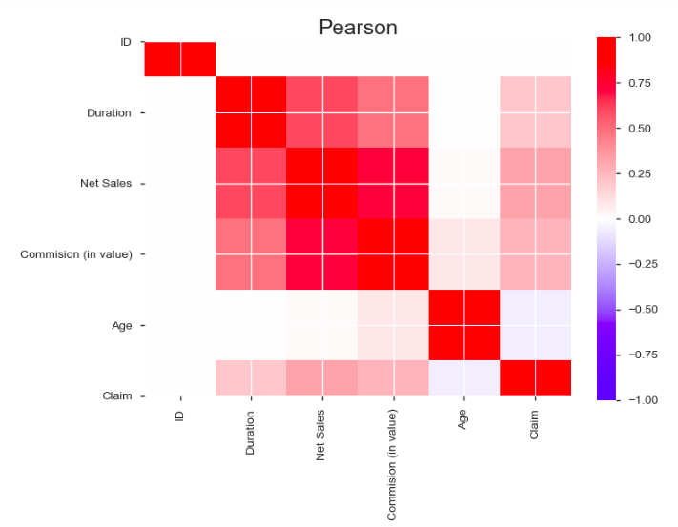
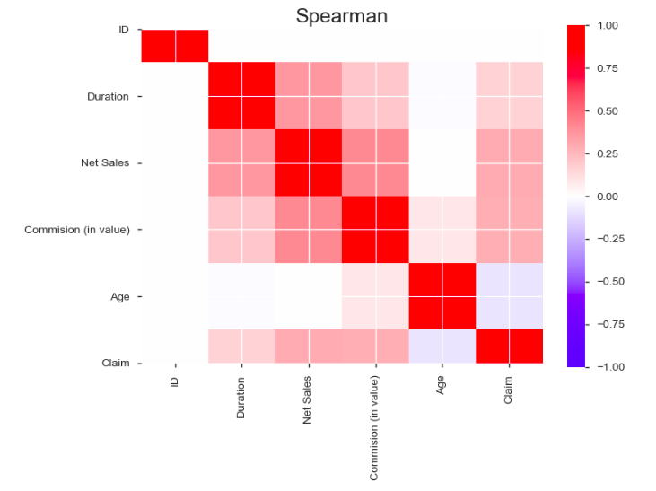
Correlations

Slide 11
Pipeline
In order to reduce the variation in data, we categorized the following columns:
Age
Agency
Product Name
Destination

Slide 12
Models and Approaches
We have used the Logistic regression ,Random forest classifier ,decision tree, Ada-boost and gradient boosting on the dataset.
Random forest is the model which outperformed other models.
We started with a logistic regression model and decision tree, but they weren’t performing as expected. That is why we choose to go with random forest classifer with gave comparatively better results.

Slide 13
Evaluation & Results
The model is evaluated based on the precision score which indicates how precisely can the model determine whether the claim should be sanctioned or rejected.
Precision is the ability of a classification model to identify only the relevant data points.
Our model gave a good precision score of 0.85

Slide 14
Final Results
The precision scores for different models is given below:
Decision Tree CLF: 0.71
Adaboost : 0.64
Random Forest CLF : 0.85
Xgboost : 0.64
Logistic regression CLF : 0.63
As you can see, the best performing model is Random Forest CLF.

Slide 15
Insights & Decisions
The age group which falls under the ‘Adult’ class, has a higher chance of getting his/her claim accepted.
So we can interpret that our model will predict the accurate claim to sanction or not 85% of the time correctly.
Business can provide packages to include additional benefits for fellow travellers belonging to Senior citizen and kids age groups at some increased cost which would attract more customers. This would increase profit as the claims for these age groups are less as compared to other age groups.

Slide 16
Next Steps
If we had more time, then we would have implemented the following things in our model:
Grid Search CV
Different ensembling methods(stackng)
Tweaked some more hyper-parameters of the models.

Slide 17
Thank you!

